Slide 1
2017
Product Roadmap
2017/08/31
RuggON keeps the right to do any change without any notification.

Slide 2

RuggPAD
Fully Rugged Tablet

Slide 3

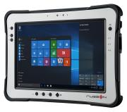
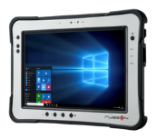


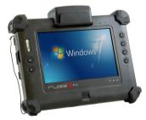
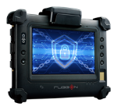
RuggPAD Product Portfolio
RuggPAD Products
Rextorm
PX-501 (Gen I)
PX-501B (Gen II)
PM-521
PX-501C (Gen III)
Intel Core i5 4300U
Windows Version
Intel Core i5 5350U
Windows Version
Intel Atom E3827
Windows / Android Version
Intel Core i5 7300U
Windows Version
Blaxtone
PM-522
PM-311
PM-311B
Intel Atom E3827
Windows Version
Intel Atom N2600
Windows Version
Intel Celeron N2930
Windows Version
MP
Plan /Development

Slide 4


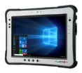

Rextorm Series Roadmap
LCD Size
10.4-inch
PX-501
PX-501B
PM-521
PX-501C
Core-i Haswell i5-4300U
10.1” 1000nits; 1920 x 1200; P-CAP; Digitizer
Win10/Win8/Win7;
4GB DDR3L; 128GB SSD
Core-i Broadwell i5-5350U
10.1” 1000nits; 1920 x 1200; P-CAP; Digitizer
Win10/Win8/Win7;
8GB DDR3L; 128GB SSD
ATOM Bay Trail E3827, 4GB DDRIII; 128GB SSD
10.1” 1000nits; 1920 x 1200; P-CAP
in10/Win8/Win7/AN4.4
Core-i Kaby Lake i5-7300U
10.1” 950nits; 1920 x 1200; P-CAP; Digitizer
Win10;
8GB DDR3L; 128GB SSD
WLAN/BT/WWAN
Dual Camera, GNSS
BCR/NFC/SmartCard Reader
EOL @ 2018/06/30
Q4’17
7-inch
2017
MP
Developing
Planning
Target MP Date

Slide 5

Rextorm Series Accessories Roadmap
Type
Factory Option
Snap-on
SN203-HI01
SN203-SN01
HDMI Input Module
Model : PX-501 Gen-III
1x Smart Card Reader
1x NFC Reader
Model : PX-501 Gen-III/Gen-II and PM-521
Q2’18
SN203-UHF01
UHF RFID Reader
Model : PX-501 Gen-III
Q2’18
2017
2018
MP
Developing
Planning
Target MP Date

Slide 6

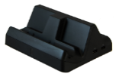

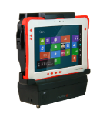
Rextorm Series Accessories Roadmap
Application
Office Application
EB200
DT04-S/F
DT06-F
Battery Slot x2
Model : PX-501/PM-521
2x USB and others…
Model
S SKU : PX-501 Gen-I/II,
and PM-521 Android SKU
F SKU : PX-501 Gen-I/II,
and PM-521 Windows SKU
2x USB3.0 and others
Model : PX-501 Gen-III
Q1’18
VESA Bracket
In-Vehicle Application
Model : PX-501/PM-521
VD04-M/S/F
VD06-F
2x USB and others…
2x RF Pass-Through Conn.
Model
M SKU : All PX-501, PM-521
S SKU : PX-501 Gen-I/II, and
PM-521 Android SKU
F SKU : PX-501 Gen-I/II, and
PM-521 Windows SKU
2x USB3.0 and others
2x RF Pass-Through Conn.
Model : PX-501 Gen-III
Q4’17
2017
2018
MP
Developing
Planning
Target MP Date

Slide 7

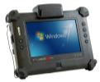
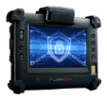
Blaxtone Series Roadmap
LCD Size
10.4-inch
PM-522
ATOM Bay Trail E3827
10.4” 700nits; 1024 x 768;
P-CAP Touchscreen
Win10
4GB DDR3L; 64GB SSD
7-inch
PM-311
PM-311B
ATOM Cedar Trail N2600
7”; 1280 x 800;
5-wire Resistive Touch
Win7
2GB DDRIII; 32GB SSD
Celeron Bay Trail N2930
7” 850nits; 1024 x 600; P-CAP
Windows 10
4GB DDR3L, 128GB SSD
WLAN/BT/WWAN
Dual Camera(2MP/8MP), GNSS,
Capacitive Fingerprint(508dpi) Fanless
EOL @ 2018/09/30
2017
MP
Developing
Planning
Target MP Date

Slide 8
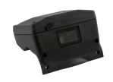
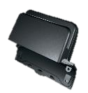

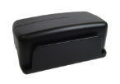
Blaxtone Series Accessories Roadmap
Type
Factory Option
Snap-on
BC01
SN201-GC01
SN202-MB01
1D/2D BCR
Model : PM-522
GPS Module
Smart Card Reader
Model : PM-522
MSR Module
1D/2D BCR
Model : PM-311 / PM-311B
MR01
MSR Module
Model : PM-522
SN202-MM01
MSR Module
MRZ Module
Model : PM-311B
2017
MP
Developing
Planning
Target MP Date

Slide 9
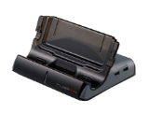


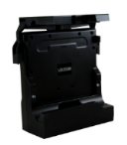
Blaxtone Series Accessories Roadmap
Application
Office Application
DT02M
DT03C
DT05
USB x4 and others…
Model : PM-522
USB x4 and others…
Model : PM-311
USB x4 and others…
Model : PM-311B
VESA Bracket
Model : PM-522
In-Vehicle Application
VD200M
VD03C/
VD03C-DIO
VD05
USB x4 and others…
Model : PM-522
USB x4 and others…
Model : PM-311
USB x4 and others…
Model : PM-311B
2017
MP
Developing
Planning
Target MP Date

Slide 10
RuggVMC
Rugged In-Vehicle Computer

Slide 11
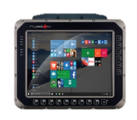
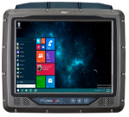
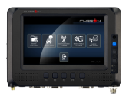


RuggVMC Product Portfolio
VMC Products
RVT
VM-521-HR
VM-521-LR
VX-601
VM-601
Intel Atom E3845
Windows Version
Intel Atom E3827
Windows Version
Intel Core i5 6300U
Windows Version
Intel Apollo Lake
Windows Version
MDT
MT7000
MT7000
MT7010
Intel Atom E3826
Windows Version
Intel Atom E3815
Android 4.4
Qualcomm 210
Android 5.1
PDT
PT8000
ARM Processor
Android 5.1
MDC
DC2000
ARM Processor
Linux Version
MP
Plan /Development

Slide 12

MDT Series Roadmap
Platform
ARM MDT
MT7010
Qualcomm Quad-Core 1.1GHz
Android 5.x
7” TFT LCD (1024x600)
PCT touch
1GB LPDDR2 on board
8GB eMMC
Built-in backup battery
OBDII / CAN bus
GPS/ WLAN / BT / WWAN
ISO7637-2 / SAE J1455
OP: -20 ~ 70 ℃
Q3’ 17
X86 MDT
MT7030
MT7000
Intel ATOM E3815 / E3826
Win10 IoT Enterprise;
Android 4.4
7” TFT LCD (1024x600)
PCT touch
2GB DDR3L on board
mSATA I/F Storage
Built-in backup battery
SAE J1939 /OBDII / CAN bus
GPS/ WLAN / BT / WWAN
ISO7637-2 / SAE J1455
OP : -30 ~ 60 ℃
Intel Apollo Lake E3930
Win10 IoT Enterprise
7” TFT LCD (1024x600)
PCT touch
2GB DDR3L on board
mSATA I/F Storage
Built-in backup battery
OBDII / CAN bus
GPS/ WLAN / BT / WWAN
ISO7637-2 / SAE J1455
OP : -30 ~ 60 ℃
Q4’ 18
2017
2018
MP
Developing
Planning
Target MP Date

Slide 13

PDT Series Roadmap
Platform
ARM PDT
PT8000
Qualcomm Quad-Core 1.1GHz
Android 5.x
8” TFT LCD (TBD)
PCT touch
2GB DDR3L on board
16GB eMMC
Built-in backup battery
OBDII / CAN bus
GPS/ WLAN / BT / WWAN
ISO7637-2 / SAE J1455
OP : -30 ~ 70 ℃
X86 PDT
Q2’ 18
2017
2018
MP
Developing
Planning
Target MP Date

Slide 14
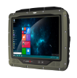
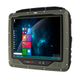
RVT Series Roadmap
LCD Size
10.4-inch
VM-521
VM-522
Intel Atom E3845 / E3827
Windows Embedded Standard 7/8
Win10 IoT Enterpirse
10.4” TFT LCD (1024x768)
Resistive touch
2GB DDR3L SODIMM, up to 8GB
2.5” SSD Bay
Built-in backup battery
CAN bus support
GPS built-in
WLAN / BT / WWAN
IP66
OP : -30 ~ 55 ℃
Intel Apollo Lake E3950
WIN10 IoT Enterprise
10.4” TFT LCD (1024x768)
Resistive touch / optional PCT
4GB DDR3L SODIMM, up to 16GB
Storage M.2 slot
Built-in backup battery
CAN bus support
GPS built-in
WLAN / BT / WWAN
IP66
OP : -30 ~ 55 ℃
Q3’ 18
7-inch
2017
2018
MP
Developing
Planning
Target MP Date

Slide 15
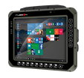
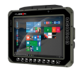

RVT Series Roadmap
LCD Size
15-inch
VX-701
Intel Kaby Lake
WIN10 IoT Enterprise
15” TFT LCD (1024 x 768)
Resistive touch; optional PCT
4GB DDR4 SODIMM, up to 16GB
Storage M.2 slot
Built-in backup battery
CAN bus / OBDII /SAE J1939
GPS/ WLAN / BT / WWAN
IP66
OP : -30 ~ 55 ℃
Q3’ 18
12.1-inch
VX-601
VM-601
Intel Sky lake Core i5 6300U 2.4Ghz
WIN10 IoT Enterprise
12.1” TFT LCD (1024 x 768)
Resistive touch; optional PCT
4GB DDR3L SODIMM, up to 16GB
Storage M.2 slot
Built-in backup battery
CAN bus/ OBDII/ J1939
GPS/ WLAN / BT / WWAN
IP66
OP : -30 ~ 55 ℃
Intel Apollo Lake E3950
WIN10 IoT Enterprise
12.1” TFT LCD (1024 x 768)
Resistive touch; optional PCT
4GB DDR3L SODIMM, up to 16GB
Storage M.2 slot
Built-in backup battery
CAN bus / OBDII /SAE J1939
GPS/ WLAN / BT / WWAN
IP66
OP : -30 ~ 55 ℃
Q2’ 18
2017
2018
MP
Developing
Planning
Target MP Date

Slide 16
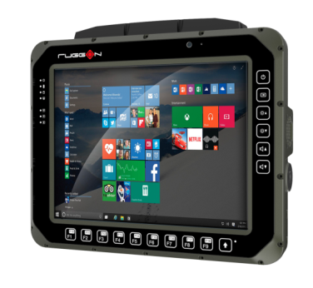
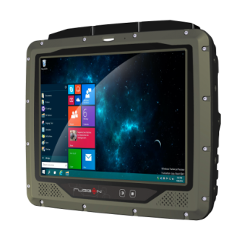

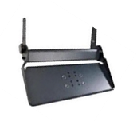

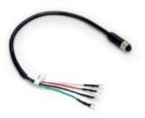
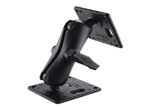



RVT Series Accessories
Antenna
DB9 to OBDII Cable
Power Cable
Mount Kit
U-Shape Kit
Mount kit
for keyboard
Holder kit
for Barcode
Antenna & Power Cable
Mounting Kit

Slide 17
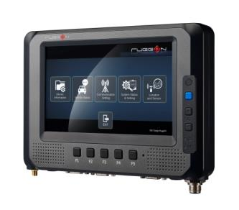
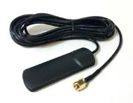
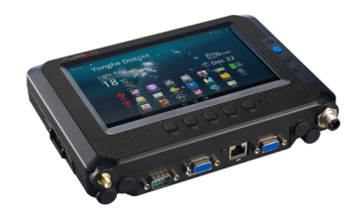
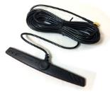

MDT Series Accessories
Mount Kit
Mounting Kit
WWAN Antenna
WIFI / BT Antenna
Antenna Cable

Slide 18


